Slide 1
Culminating Presentation:
Jump Rope City
Kamin Fay, Celine Fucci, Kevin Ho, Ethan McGowan, Jalen Pestillo

Slide 2
System Intent
Jump Rope City is a programming game where players write MiniAT programs to jump over ropes.
Notes:
Kevin

Slide 3
Cycle Intent
Our goal was to deliver a finalized product by:
Fully integrating MiniAT
Prioritizing graphics work
Allowing the player to conquer/jump over ropes
Notes:
Ethan
In this cycle we had a few main goals that we as a team were trying to focus on to try and better our project as a whole. The first goal we had was to fully integrate MiniAT into our project so that the movements could be controlled by the MiniAT code. Another goal we were focusing on was implementing more visually appealing graphics into our game, for example a nicer background, better looking ropes, and a nicer looking player character. Last of all, we were focusing on allowing the player to jump over and conquer ropes around the map, which would then lead to the rope being deleted off of the screen.

Slide 4
Final Cycle Plans
Improving the tiling system
Improving the MiniAT movement
Implementing rope detection
Adding more animations/graphics
Notes:
Celine
To draw on what Ethan was saying, some of our final cycle plans were to improve the tiling system, MiniAT movement, implement rope detection, and adding more animations/graphics. Instead of using a static color for our background, we created an image using Photoshop, which you will see in our demo. Rope detection was important for us as well because otherwise our game wouldn’t have had any functionality and we wanted to show some progress. Additionally, we worked hard to get MiniAT movement fully functioning. However, we struggled with some Assembly stuff. Since it was one of our goals from the beginning, this was a vital step for us.

Slide 5
Processes
Design Docs:
http://bit.ly/2pnqwWc
Testing Docs:
http://bit.ly/2qtbg9Z
Notes:
Celine
In this slide, we’ll be detailing some of our processes, specifically our design and testing docs.
This is the general format for our design docs. We started with an overview of the feature then included reference material. In this design doc, you can see images of some of our drawings. These are mockups of what the feature is and how it will work. This design doc also contains some of our decisions. It was important for us to document our decisions so that we could agree on everything as a team. Finally, our testing section depicts any tests we were working on for the feature.
This is one of our testing documents. It contains some information on testing logic and testing parameters. Like the design doc, it serves as an organizational tool for us as a team. Included in this specific one are screenshots of an assembly program and a python script written for user movement, which Kamin will explain next.

Slide 6
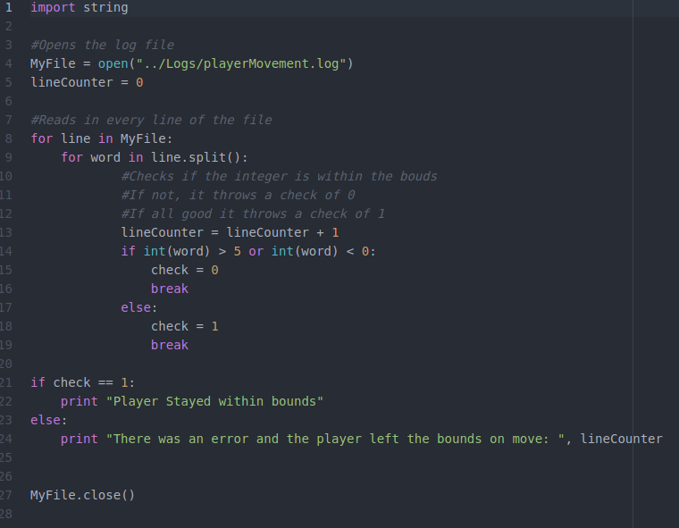
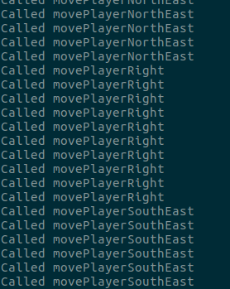

Testing Mapped To Features
Notes:
Kamin

Slide 7
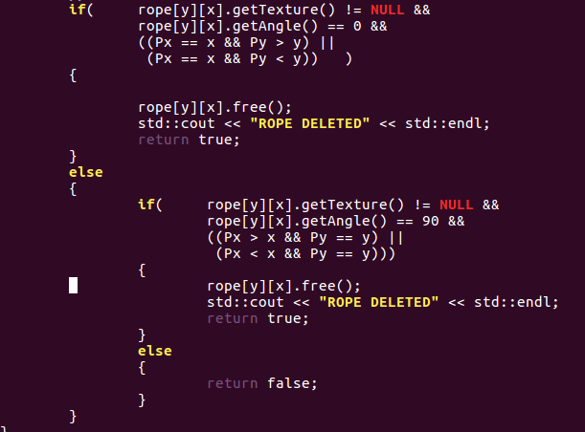
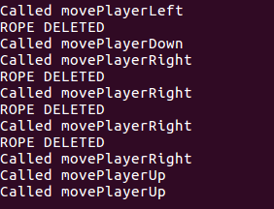
Testing Mapped To Features
Notes:
Kevin -- This could be mapped to a log file and then parsed python to allow for testing where I pass in the X and Y coordinates before and after the player goes on a rope and if the rope is destroyed

Slide 8
Final Cycle Issues
Integration with MiniAT
Attempted last minute overhaul
Unexpected adjustments
Rope deletion
Notes:
Jay
Final Cycle Issues
During the last cycle we encountered a couple of major issues such as passing a player object and not the reference of the player object.
This led to a big decision in which we started overhauling all of our code until we figured out that the underlying problem was that we were passing the actual object rather than just the reference. Once we discovered our error we began fixing the problem rather than continuing to overhaul all of our code.
Also we needed to quickly figure out the Assembly language and implement the use of Assembly files.
The last thing we needed working and tested was rope deletion. Becuase Without rope deletion it wouldn’t really be a game.

Slide 9
Lessons Learned
Emulating the experience of working on a software engineering team:
Coordinating and scheduling
Team communication
Ups and downs of making a software product
Notes:
Jay
Lessons Learned
This project was a challenging to everyone in the group between coordinating meetings outside of class to scheduling who’s coding and testing what.
Overall we did fairly well at communicating as a group by using slack, but we definitely struggled to stay on the same page and agree upon certain things.
The overall project has definitely taught us that communication between a team of developers is a major key. As I mentioned before a lack of communication and decision making led our group to almost overhaul all of our code.

Slide 10
Demo
Final Cycle

Slide 11
Conclusion
Questions? Comments?
Thank you.
Notes:
Celine
In conclusion, we enjoyed the experience of what it was like to work on a software development team. Even though it had its ups and downs, we learned a lot and hope to use our knowledge in future classes.

